Slide 1
Lion tech: on campus phone repairs
Deondis Mendenhall
Taylor Hogan
Isabella Roland
Erica Pierce
Zarif Shadman

Slide 2
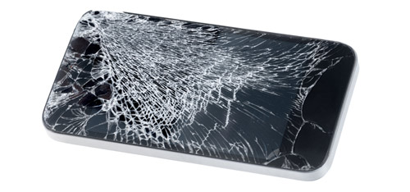
PRoblem: CRACKED PHONE SCREEN 30% of people in the US currently have a cracked screen.

Slide 3
Lion tech fixes phones on campus
By students for students
Conveniently located
Affordable pricing

Slide 4

PRomise
cost, convenience, credibility meets all the needs of students

Slide 5
Market size:
Target market – Shoals Area population 150,000
119,000 within our age demographic 14-75
76,000 own smartphones
Common problem, often reoccurring

Slide 6
Survey results:
100 people surveyed
99% of participants support Lion Tech’s mission to fix phones on campus
85% of participants are comfortable leaving their phone to be repaired

Slide 7
Competitive pricing: $75 flat rate on all repairs

Slide 8
Business model:
Labor: $7.25 x 300 hours = $2175
Rent: $13 x 300 sq. ft. = $3,900
Assuming 10 repairs a week (low estimate)
Parts: $30 kit x 200 phones = $6000
Cost per phone $60
Repair cost $75
Profit per repair: $15
With 200 phones repaired profit will be $3,000

Slide 9
Why now?
Students want it
Students look for it
Students need their phone
Students satisfaction
Student employment
Student resource

Slide 10
Advertising Strategy
Social Media
Facebook
Snap Chat
Instagram
Twitter
Apps
Newspaper
Websites

